Slide 1
Open Source Platform and Network Administration
Lesson 25

Slide 3

Remote Logging
Step 1: Open the /etc/rsyslog.conf file in a text editor.
Step 2: Add the line *.* @10.10.10.4:514.
Step 3: Save and exit.
Step 4: Open the /etc/rsyslog.conf file in a text editor.
Step 5: Add the line $ModLoad imudp.so.
Step 6: Add the line $UDPServerRun 514.
Step 7: Save and exit.
Web Server
Internet Protocol
(IP) 10.10.10.9
All logs on 10.10.10.9 will be sent to 10.10.10.4 over User Database Protocol (UDP) Port 514
Remote logging Server
IP 10.10.10.4

Slide 4



Remote Monitoring and Logging
Used to consolidate monitoring and logging of all servers for easier and more effective monitoring of computer systems in a network
Linux system administrator
monitors from a central location
Logging and
monitoring server
Linux system logs
Firewall logs

Slide 5
Logwatch
It is a program written in Perl scripting language that consolidates information from various log files and creates a report.
In Fedora, it is installed by default and runs daily.
Its main configuration file is /etc/logwatch/conf/logwatch.conf.
Its configuration allows to set range of dates from the log files. By default, it reads logs from the previous day.
The reporting level of activity can be set as low, medium, or high.

Slide 6
Logcheck
It is used mostly on Debian-based systems, such as Ubuntu.
By default, it runs every hour and upon a reboot.
Its main configuration file is /etc/logcheck/logcheck.conf.
The log files to monitor are set in the /etc/logcheck/logcheck.logfiles file.
It supports paranoid, server, and workstation levels of output.

Slide 7
Identify System State Baseline
Collect list of packages
Compare files, Permissions, and ownership
Define baseline network configuration
Collect runtime information

Slide 8
Host-Based Intrusion Detectors
Provide a solution to the “needle in the haystack” problem
Provide a layer of security
Help establish a baseline for files, processes, and ports

Slide 9
File Integrity Checkers
Tripwire
Advanced Intrusion Detection Environment (AIDE)
Chkrootkit
Rootkit Hunter (rkhunter)
Notes:
Tripwire
Stores a security policy containing rules for all files to be checked. When a file changes, Tripwire compares it against the checksum and fires an alert.
Advanced Intrusion Detection Environment (AIDE)
Developed as a replacement for Tripwire
Works within the same concept as Tripwire
Chkrootkit
Checks system binaries for modifications
Checks other files as well for rootkits and worms known to Linux
Rkhunter
Checks for rootkits and other vulnerabilities

Slide 10
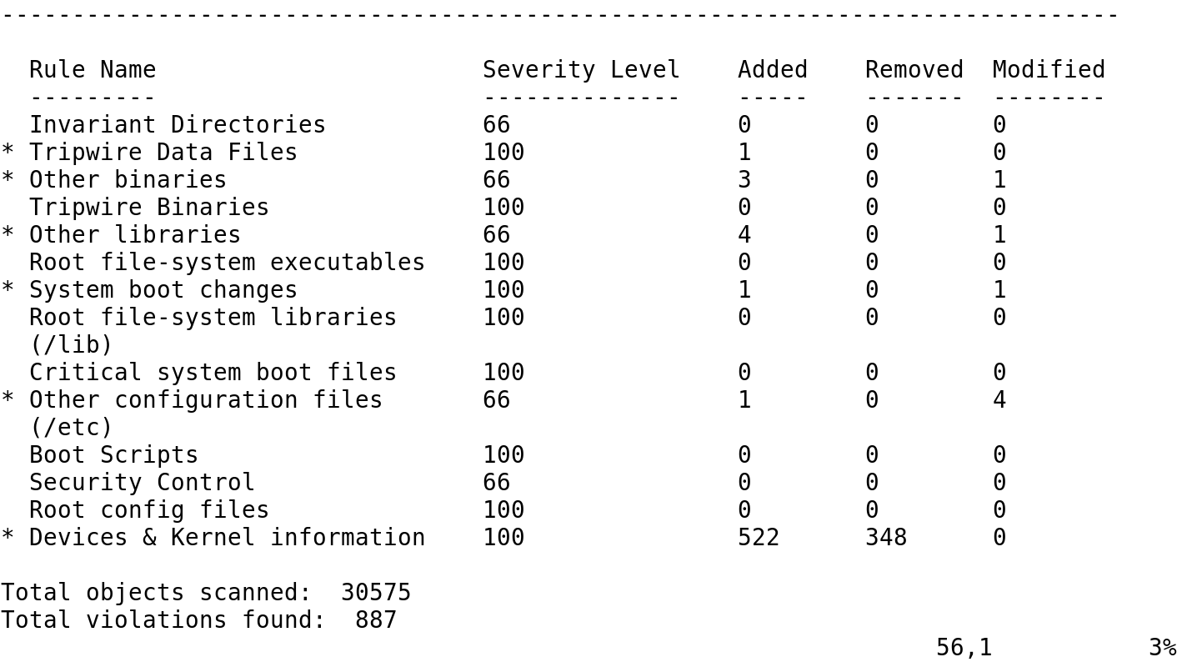
A Tripwire Check

Slide 11
Summary
A secure baseline Linux system
Read-only versus live bootable operating systems
Local and remote log configuration
File and data integrity checkers

Slide 12
Virtual Labs
Applying Best Practices for Security Logging and Monitoring
Notes:
If your educational institution included the Jones & Bartlett labs as part of the course curriculum, use this script to introduce the lab:
"In this lesson, you learned the importance of a good baseline that keeps installed software to a minimum and controls against unauthorized access. The quality of the baseline can be monitored with logs and with IDS tools such as Tripwire, a third-party software tool that helps monitor the Linux server for changes.
In this lab, you will configure remote logging in the CentOS Linux Server and send syslogs to a remote host for secure secondary logging. You will use Tripwire, a third-party file integrity tool, to identify modifications to important system files. You will configure Rootkit Hunter, (rkhunter), to search for rootkits and other anomalies on a set schedule. You also will search the log files for specific criteria."

